Slide 1
Secure data hiding in image using steganography
CAPSTONE PROJECT
Presented By:
Student Name : Pinjari Mohammed Shamsheer
College Name & Department : G.Pullaiah College of Engineering and Technology & Computer Science and Engineering

Slide 2
OUTLINE
Problem Statement
Technology used
Wow factor
End users
Result
Conclusion
Git-hub Link
Future scope

Slide 3
Problem Statement
Traditional encryption converts data into ciphertext, making security evident. In contrast, steganography hides messages within images, ensuring covert communication without detection. This method prevents suspicion by embedding data invisibly, offering a discreet way to protect sensitive information while maintaining the original appearance of the carrier image.

Slide 4
Technology used
Programming Language: Python
Libraries: OpenCV (cv2), OS, String Manipulation
Platform: Local Execution

Slide 5
Wow factors
Encrypts messages inside images without noticeable changes.
Uses a passcode for secure decryption.
Minimal computational overhead.

Slide 6
End users
Cybersecurity professionals
Government agencies
Secure communication applications

Slide 7
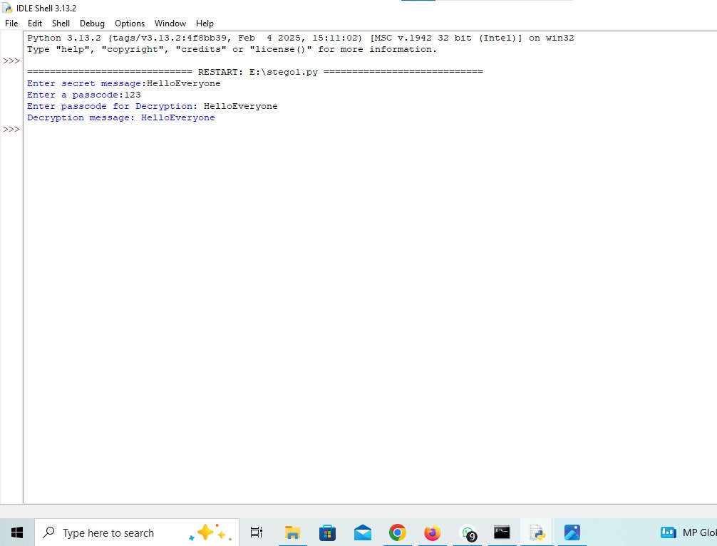
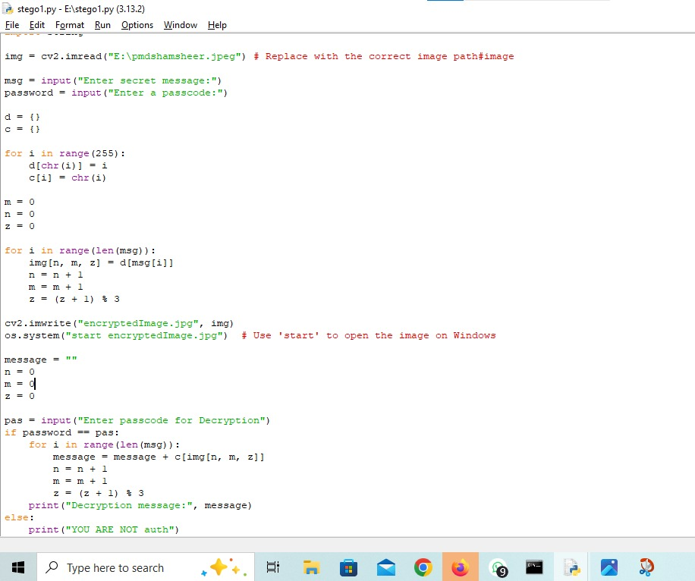
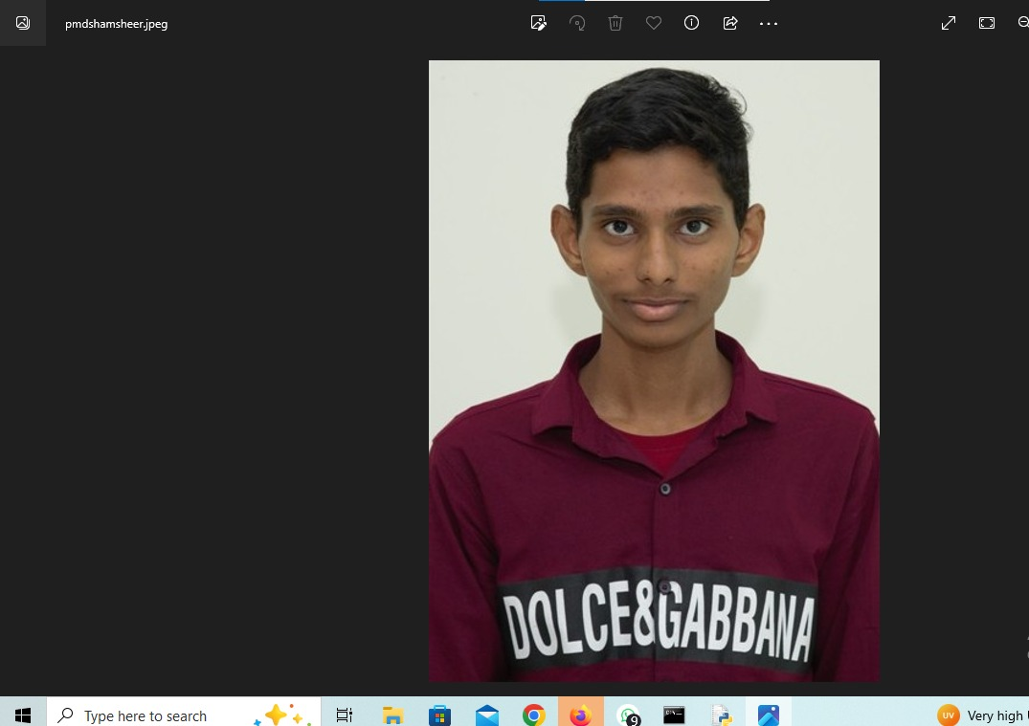
Results

Slide 8
Conclusion
This project demonstrates a simple yet effective steganography method, enhancing covert communication and security.

Slide 9
GitHub Link
https://github.com/pmdshamsheer/CyberSecurity-Project.git

Slide 10
Future scope(optional)
Implementing stronger encryption layers.Developing a user-friendly GUI.Extending support to audio and video steganography.

Slide 11
THANK YOU

